Slide 1
Creating a Thermal Shroud
Jessica Avitia
Aerospace Engineering Undergraduate Student
Embry-Riddle Aeronautical University, Prescott AZ
Mentors:
Dr. Ronald Madler
Jack Crabtree

Slide 2
Reason
For Thermal System Detail Group
Future payload testing

Slide 3
Project Goal
Create a thermal shroud to simulate space environment
Create a thermal plate prototype to test the concept
Create a thermal shroud from the prototype

Slide 4
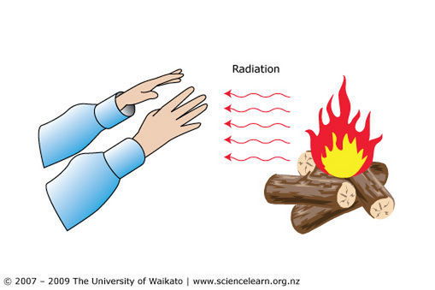
Heat Transfer
(sciencelearn, 2009)

Slide 5
Heat Transfer

Slide 6
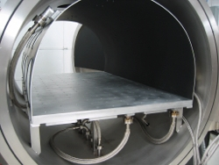
Background
Thermal Shrouds simulate space environment
Place inside vacuum chambers
Helps the system reach equilibrium temperatures
(Angstromengineering, 2010)

Slide 7
Experimentation
Researched Thermal Shrouds
  Material properties / liquid nitrogen
Created a thermal plate prototype for testing
Adjusted thermal plate
Created a thermal shroud for thermal systems detail design group

Slide 8
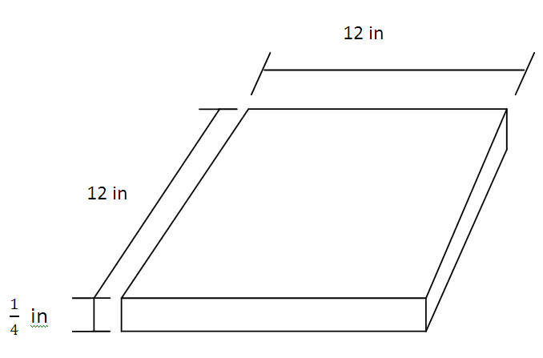
Thermal Plate
¼ inch 2024 aluminum plate

Slide 9
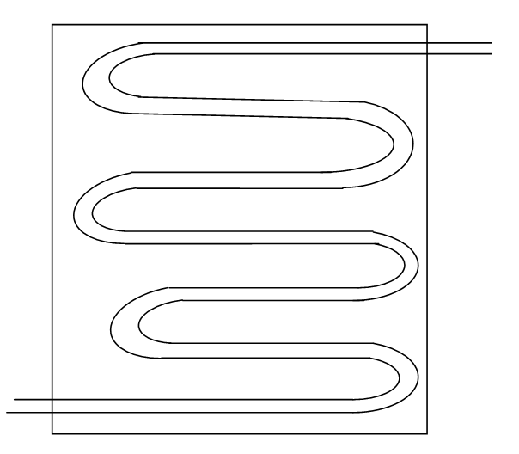
Thermal Plate
Type K copper tubing
½ inch inner diameter

Slide 10
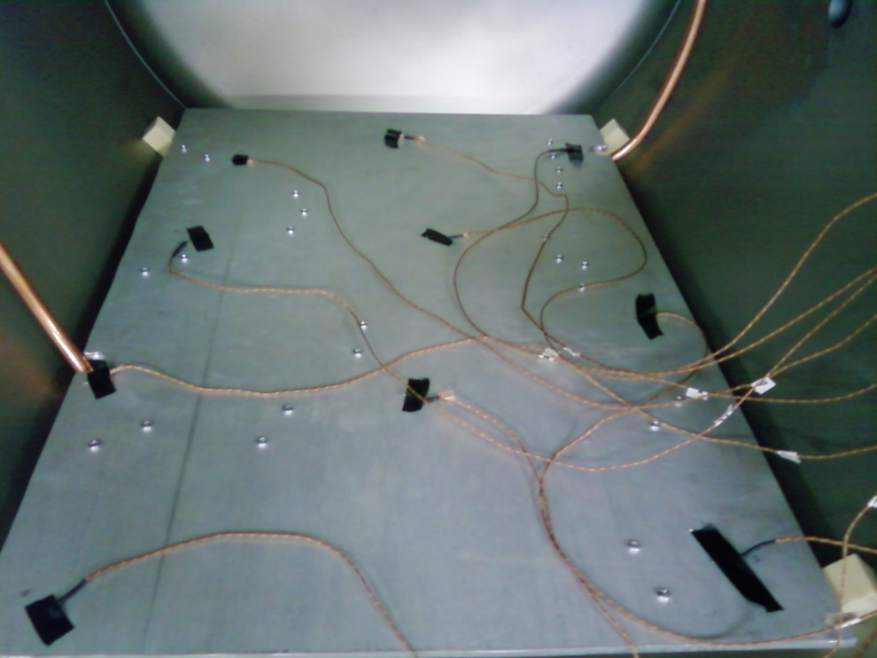
Testing
10 thermocouples placed on thermal plate
Drop vacuum chamber to 0.038 Torr (pressure)
Ran liquid nitrogen for one hour
Recorded data from thermocouples
10
8
9
7
6
3
1
5
4
2

Slide 11
After Experiment

Slide 13
Results
Thermocouples and liquid nitrogen behaved as expected
Thermal plate reached a temperature of approximately -250 °F

Slide 14
Conclusion
From my thermal plate prototype Thermal System Detail Group was able to create a full size thermal shroud
(GES,2009)

Slide 15
(GES,2009)
(GES,2009)

Slide 16
Acknowledgements
Dr. Madler
Jack Crabtree
Chris Smith
Dr. Haven
Thermal System Detail Group
NASA Space Grant
Questions????

